Slide 1
PRINCIPLES OF GLOBAL ECONOMICS
Chapter 11: Public Goods and Common Resources

Slide 2
Preview
Many goods and services we consume are available free of charge:
Public parks, toll-free highways, clean air, etc.
In the absence of prices, the market forces that normally allocate resources are also absent.
The invisible hand cannot operate, since it relies on market prices that do not exist in these cases.
Private markets cannot ensure that such goods are provided and used efficiently to maximize society’s welfare as a whole.
Principle #7: “Governments can sometimes improve market outcomes.”

Slide 3
Different Kinds of Goods

Slide 4
Different Kinds of Goods
Up to this point, we have been making two implicit assumptions about the goods and services we analyzed: they were rival in consumption and excludable.
Rivalry in Consumption
If one person’s use of a unit of a good reduces another person’s ability to use it, the good is rival in consumption.
e.g., If someone drinks a cup of coffee, it is gone, and nobody else can have that same cup of coffee.
Excludability
If people can be prevented from using a good, it is excludable.
e.g., If a cup of coffee belongs to you, nobody else can consume that same cup.
Goods that are both excludable and rival in consumption are called Private Goods.

Slide 5
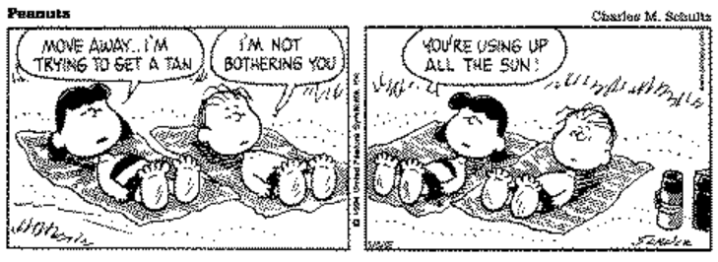
Rival vs. Non-Rival
Many goods are rival in consumption, meaning that if one person consumes the good, another cannot consume it:
e.g., A cup of coffee
e.g., Fish in the local lake
Some goods are non-rival in consumption, meaning that even if one person consumes the good, others can still enjoy it simultaneously:
e.g., Tornado sirens
e.g., Streaming movies on Netflix
If one person’s use of a unit of a good reduces another person’s ability to use it, the good is rival in consumption.

Slide 6
Excludable vs. Non-Excludable
Some goods are excludable in consumption, meaning that consumers can be prevented from using the good:
e.g., A cup of coffee
e.g., Streaming movies on Netflix
Some goods are non-excludable in consumption, meaning that consumers cannot be prevented from using the good:
e.g., Fish in the local lake
e.g., Tornado sirens
If people can be prevented from using a good, it is excludable.

Slide 7
Different Kinds of Goods
 | Rival | Non-Rival
Excludable | Private Goods “A cup of coffee” | Club Goods “Streaming movies on Netflix”
Non-Excludable | Common Resources “Fish in the local lake” | Public Goods “Tornado sirens”

Slide 8
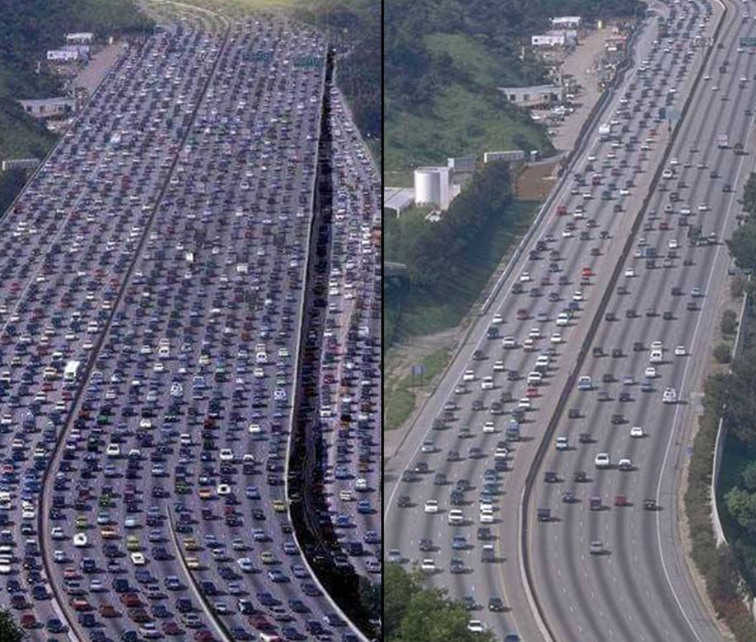
Exercise: How are Roads Classified?
Are roads Excludable?
Yes: There are private roads and toll roads that are excludable.
No: Most roads are public and toll-free.
Are roads Rival in Consumption?
Yes: In heavily congested areas, roads can be rival in consumption.
No: As long as the road is not congested, it is non-rival in consumption.
The answer is “it depends.”

Slide 9
Public Goods

Slide 10

Public Goods and Free Riders
Suppose two towns are considering building a publicly accessible highway to connect them.
This highway is non-rival, since one person’s use of the road does not prevent others from using it.
It is also non-excludable, as it is open to the public.
Therefore, this highway would be classified as a public good.
How can we fund the construction of the highway?

Slide 11
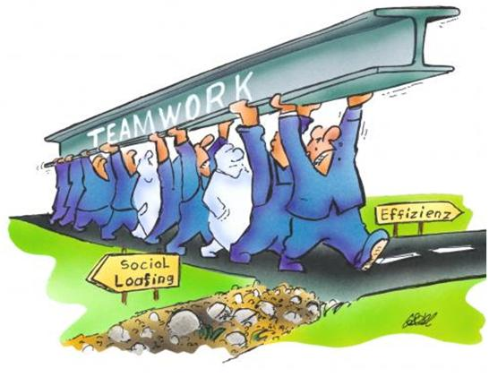
Public Goods and Free Riders
Ideally, those who would benefit from using the highway would contribute according to their Willingness to Pay (WTP).
However, once the highway is completed, there would be nothing stopping travelers from using it, whether or not they helped fund it.
Because of its non-excludable nature, such a project creates a strong incentive for people to become free riders.
Free riders are individuals who enjoy the benefits of a good or service but avoid contributing.

Slide 12
Exercise: Public Goods and Free Riders
Suppose that the two towns have a combined population of 1,000. Each resident in these two towns values having a highway connecting them at $500 each. The best estimate for the total cost of constructing the highway is $400,000.
Question #1: Should this highway be constructed?
The collective benefit residents would enjoy if the highway is completed is $500,000.
The cost of constructing the highway is $400,000.
Since the benefit exceeds the cost, the highway should be constructed.

Slide 13
Exercise: Public Goods and Free Riders
Suppose that the two towns have a combined population of 1,000. Each resident in these towns values having a highway connecting them at $500 each. The best estimate for the total cost of constructing the highway is $400,000. The mayors of the towns ask for voluntary contributions from the community, and only $300,000 is collected.
Question #2: Can the highway be constructed?
Even though the collective benefit is $500,000, some residents contribute less than their actual benefit.
This is a classic case of the free rider problem, since residents know the highway is non-excludable.
The highway should be built but cannot be built due to the lack of funds (short by $100,000).
Question #3: Can the government help build this highway?
Yes.
The government can levy a $100 tax on all residents to make up for the $100,000 shortage.

Slide 14
Public Goods, Market Failures, and the Government
Public goods are often the source of market failures, situations in which the market outcome is not efficient.
Using the framework from Chapter 10, we can think of public goods as goods that generate large positive externalities.
If one funds a public good, they confer an external benefit on others who use it without paying for it.
Therefore, even though the public good is socially desirable, it would be undersupplied if left to the market.
The government can provide the public good as long as it determines that the total benefits exceed the total costs.

Slide 15

Marginal Revolution University (2015, June 26). Public Goods and Asteroid Defense
[Video]. YouTube. https://youtu.be/lLzcW5NG5eA?si=CAu4rqu16Ukobf9D&t=10

Slide 16

Public Goods: National Defense
National defense is the classic example of a public good.
Non-Excludable: Once a military has been established, it is not possible to exclude anyone in the country from enjoying its benefits.
Non-Rival: One person being defended against foreign aggression does not prevent others from receiving the same protection.
One of the most expensive public goods.
In FY 2025, U.S. defense spending is projected to exceed $880 billion.
Roughly 13% of total federal spending and half of all discretionary spending.
One of the less controversial public goods.
While there is debate over the magnitude of spending, almost everyone agrees that the service itself is necessary.

Slide 17

Public Goods: Basic Research
Basic research is another important public good.
Non-Excludable: Once general knowledge is achieved and published, anyone can use it free of charge.
Non-Rival: One person’s use of general knowledge does not reduce its availability to others.
Basic research involves the production of general knowledge.
Private firms conduct research, but most of their work focuses on producing technical knowledge which:
Builds on the existing stock of general knowledge, and
Is often patented (excludable).

Slide 18
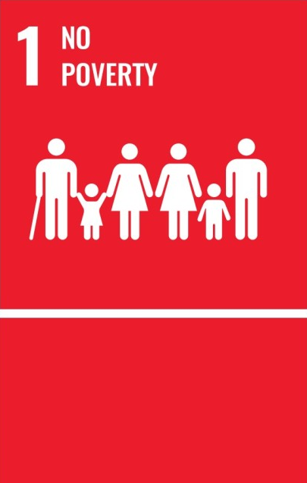
Public Goods: Reducing Poverty
If we are looking at a specific poverty reduction program…
Excludable: Only eligible individuals receive the benefits.
Rival: Distributing the benefits to one person uses up limited resources that could have gone to another.
If the public good is defined as a poverty-free society…
Non-Excludable: Once poverty is eradicated, the benefits of living in a society free of poverty is non-excludable.
Non-Rival: The benefits of living in a poverty-free world is non-rival.
Government programs target poverty reduction in the U.S.
SNAP: Subsidizes food purchases for low-income households.
Medicaid: Provides low-income households with medical care.
EITC: Tax rebates for those who work low-wage jobs.

Slide 19
Provision of Public Goods: Cost–Benefit Analysis
Recall: “The government can provide the public good as long as it determines that the total benefits exceed the total costs.”
This necessitates a cost–benefit analysis, a study that compares the costs and benefits to society of providing a public good.
The cost–benefit analysis of public goods is intrinsically difficult:
Public goods are available to everyone free of charge, so there is no market-determined price to judge their value to society.
Asking those who would benefit from the public good is unreliable, as they have an incentive to overstate the benefits.
Asking those who would lose from the public good is also unreliable, as they have an incentive to overstate the costs.

Slide 20
Common Resources

Slide 21
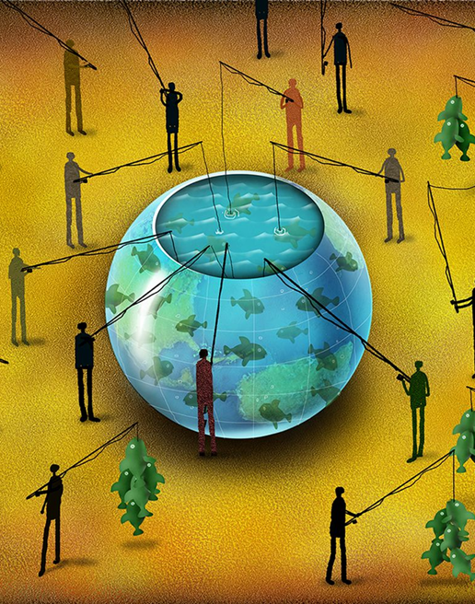
Common Resources & Tragedy of the Commons
Common resources are non-excludable, so that they are available free of charge to any who wishes to use them.
Common resources are rival in consumption, so one person’s use reduces other people’s ability to use them.
Therefore, once a common resource is provided, we must be concerned about how much it is used.
Tragedy of the Commons: A parable that illustrates why common resources are used more than is desirable from the standpoint of society as a whole.

Slide 22
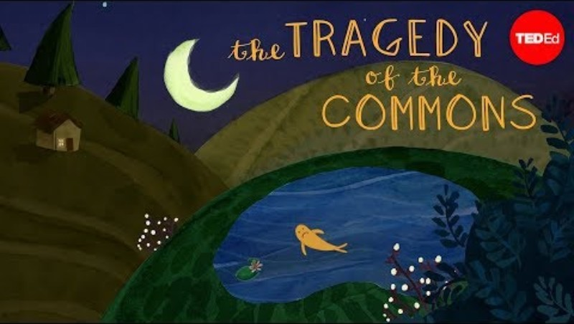
TED-Ed (2017, November 21). What is the tragedy of the commons? - Nicholas Amendolare
[Video]. YouTube. https://youtu.be/CxC161GvMPc?si=sEwXdPYzTKo2RWzB

Slide 23
Tragedy of the Commons and Externalities
Quick Recap:
Consider a local lake with a limited fish population, where the fish stock is a common resource.
If everyone acts in their own self-interest, the fish stock will be depleted.
Only through careful coordination can the fish stock remain available to everyone in the long run.
The Tragedy of the Commons arises when social and private incentives diverge.
Private: Catch as many fish as needed to meet individual needs.
Social: Catch only as many fish as needed to maintain the overall fish population.
The difference between social and private incentives can be viewed as a negative externality.
Allowing each angler to catch as much as they wish reduces the quality of the common resource.
Individuals ignore this external cost, resulting in the overuse of the resource.

Slide 24
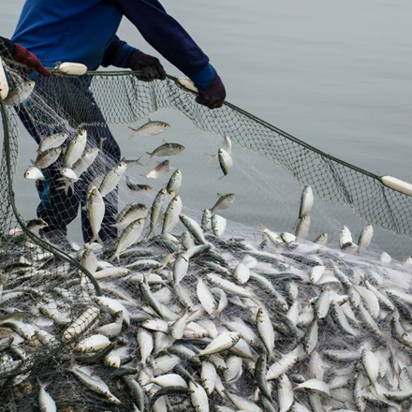
Potential Solutions
Regulation:
Limit the number of fish any angler is allowed to catch.
Corrective Taxes:
Internalize the externality by imposing a per-catch tax.
Cap-and-Trade:
Auction off a limited number of permits to catch fish.
Coasean Bargaining:
Assign property rights to the fishery, allowing townspeople to negotiate and manage usage collectively.

Slide 25
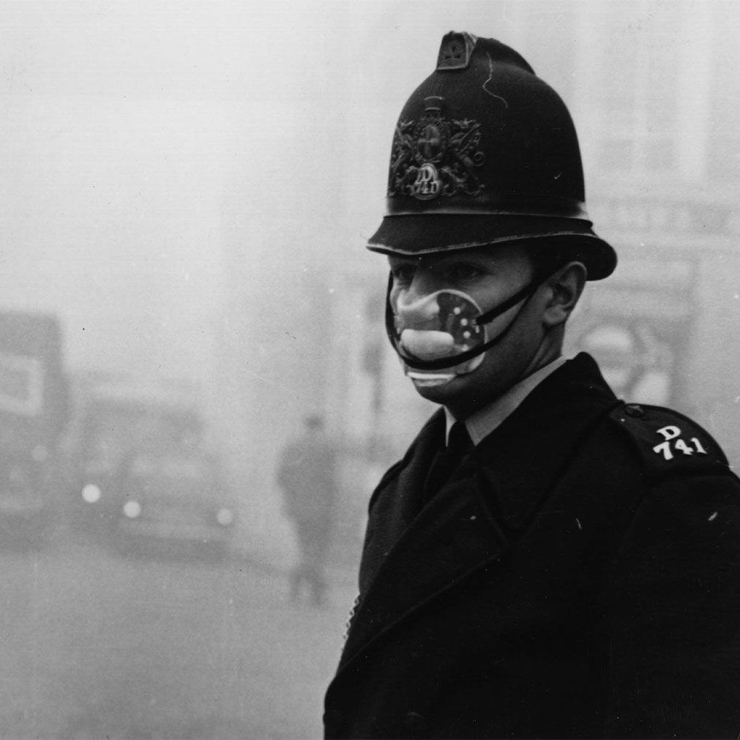
Common Resources: Clean Air
Environmental degradation is a modern example of the Tragedy of the Commons.
Clean air is a common resource:
Non-excludable: Breathing and enjoying clean air are free and available to everyone in the region.
Rival: If too many polluters emit pollutants, the quality of air decreases for everyone.
Negative Externality: Pollution
Regulations or corrective taxes are commonly used to address this problem.

Slide 26
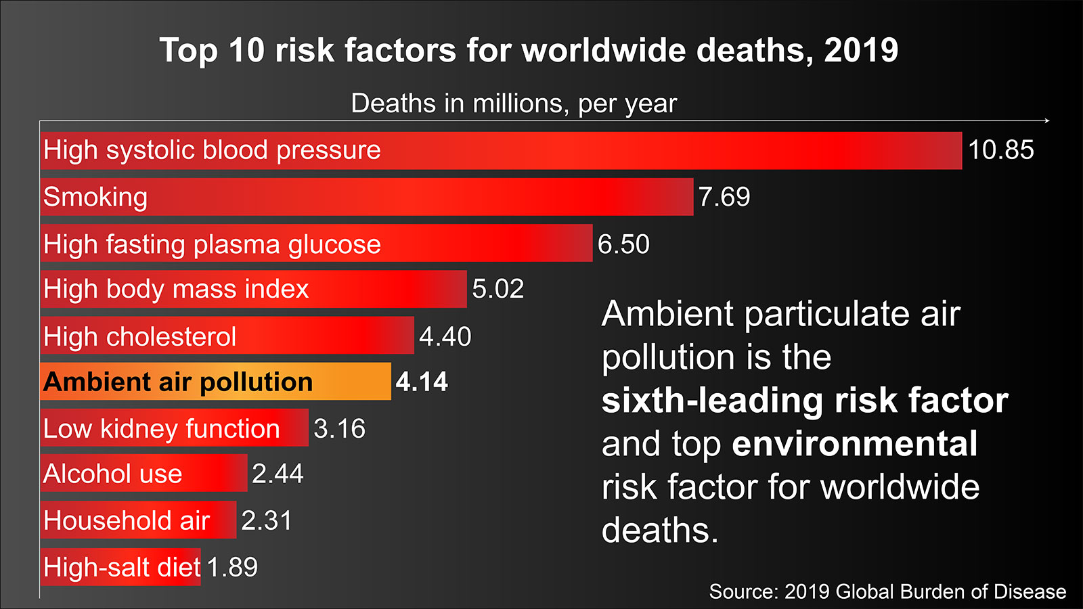
Common Resources: Clean Air

Slide 27
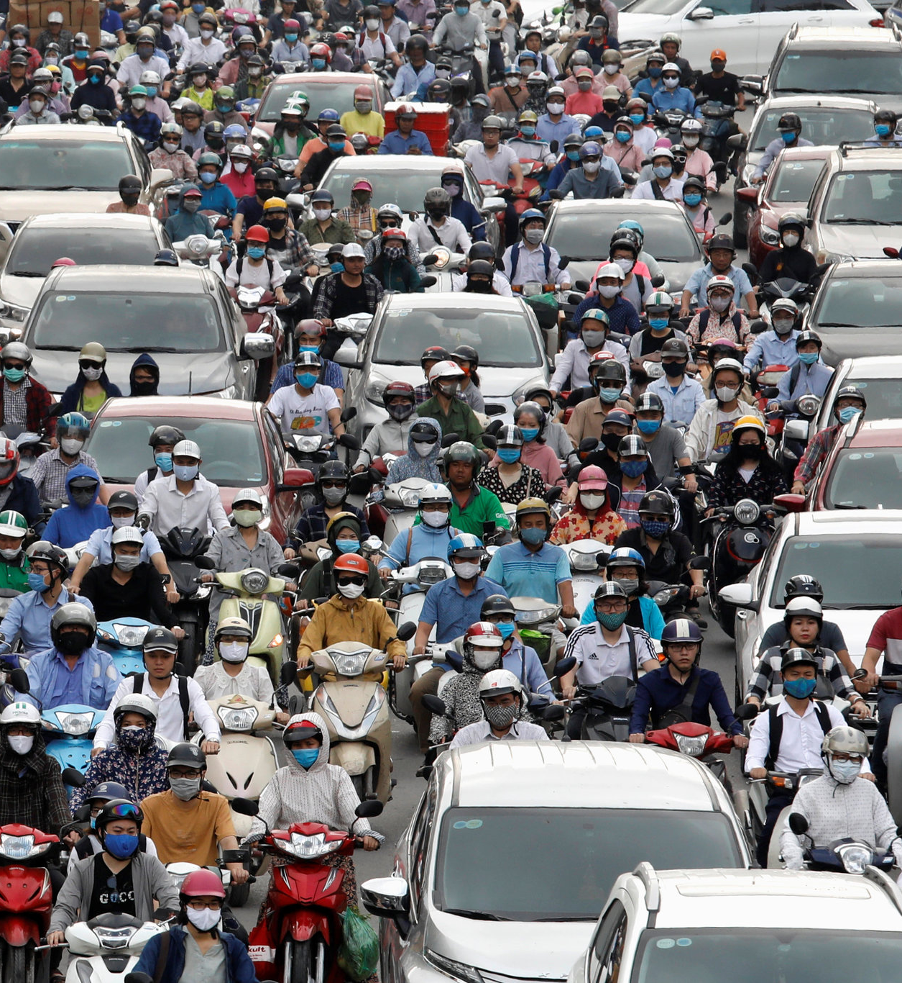
Common Resources: Congested Roads
Heavy traffic is another modern example of the Tragedy of the Commons.
Well-functioning roads are common resources:
Non-excludable: A toll-free road can be used by anyone.
Rival: If too many drivers use the road at once, the quality of travel declines for everyone.
Negative Externality: Congestion
Some solutions: Implement tolls as a corrective tax, increase toll prices during rush hours, or impose taxes on gasoline.

Slide 28

The Wall Street Journal (2023, September 22). New York City’s New Congestion Pricing, Explained
[Video]. YouTube. https://youtu.be/hgurrvho_Ug?si=dLfxllw_W3vRBMwv

Slide 29
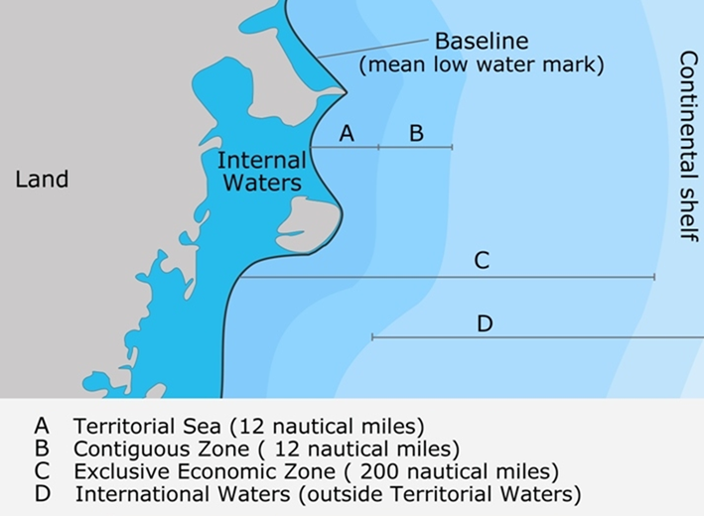
Common Resources: International Waters
International waters, also called the high seas, are areas of the ocean that lie beyond any nation’s jurisdiction.
The high seas are common resources:
Non-excludable: Open to all nations under international law.
Rival: Overfishing, pollution, and deep-sea mining diminish the ecological quality of the ocean for everyone.
Externality: Environmental harm in one region affects global ecosystems.

Slide 30

LSE (2023, May 24). The High Seas Treaty: the agreement on biodiversity beyond national jurisdiction |
LSE Research [Video]. YouTube. https://youtu.be/i0o9UvhJA-M?si=K-b7lpZ0cTICRLEa

Slide 31
Recap of Chapter 11

Slide 32
Recap
Markets fail to achieve efficiency and run into market failure when something of value has no price attached to it, and the government can potentially solve it:
Establish property rights and allow the market to self-correct.
Regulate private behavior.
Use tax revenue to supply undersupplied goods.
Excludable: A good is excludable if people can be prevented from using it.
Rival in Consumption: A good is rival in consumption if one person’s use reduces another’s ability to use it.
Public Goods: Goods that are non-excludable and non-rival in consumption.
Common Resources: Goods that are non-excludable but rival in consumption.

